Slide 1
The Kingsmen Way
July 2021
Program Overview - Team

Slide 2
The Kingsmen Way
The Kingsmen Way enables our teams to grow quality software and deliver in an iterative manner, crafting a solution that works best for our customers. Instrumental in this is the refinement, product management and business analysis that leads to the solution. We start with a customer's vision and elaborate additional levels of detail until we understand enough to complete daily tasks.
Levels and Work Item
1
Vision – Capability
1
2
3
4
5
2
Road Map – Feature
3
Release – Function
4
Iteration – User Story
5
Daily – Task

Slide 3
Additional Taxonomies
AzDO
AvidXchange
Capability
Epic
Feature
Story
Task
Theme
Epic
Feature
Story
Task

Slide 4
Continuous Planning
Continuous Strategic
Planning/Rationalization
Work is continuously prioritized and planned flowing to the delivery team for elaboration and execution. The process has feedback loops to ensure adjustments can be made based on what provides the most business value.
Architecture Runway/
Platform Improvements
Business/ Customer
Metrics and Feedback
Product Leaders invested in a successful implementation
Review/Prioritization of functions leveraging Weighted Shortest Job First (WSJF)
Meet Monthly
Operating Committee
Product owners, analyst, team leads, UX, and architecture
Break down features into functions, discuss business cases, process flows and requirements for functions. Size functions to inform prioritization and planning.
Meet every other week
Function Elaboration
5 Iteration Planning
Analyst, team leads and UX
Plan out functions by release based on sizing, team capacity, and dependencies
Meet every other week (non-iteration start/end week)
Iteration
Product owner and delivery team
Repeatable delivery process for each story included in the iteration
Happens continually on a two-week cycle
Story Elaboration
Iteration Planning
Daily Stand Up
Story Acceptance
Demo/Retro
Deploy

Slide 5
Monthly Ceremony Calendar – Program & Team
 | Op Model Layer | Monday | Tuesday | Wednesday | Thursday | Friday | Sat / Sun
Week 1 |  | 1 | 2 | 3 | 4 | 5 | 6/7
 | Program | Function Intake ⁺
 | Team | Story Elaboration | End of Iteration | Demo/Retro Iteration Planning | Story Elaboration Function Elaboration
Week 2 |  | 8 | 9 | 10 | 11 | 12 | 13/14
 | Program |  | Operating Committee
 | Team | Story Elaboration |  | 5-Iteration Planning | Story Elaboration Function Elaboration
Week 3 |  | 15 | 16 | 17 | 18 | 19 | 20/21
 | Program | Function Intake ⁺
 | Team | Story Elaboration | End of Iteration | Demo/Retro Iteration Planning | Story Elaboration Function Elaboration
Week 4 |  | 22 | 23 | 24 | 25 | 26 | 27/28
 | Program |  | Operating Committee*
 | Team | Story Elaboration |  | 5-Iteration Planning# | Story Elaboration Function Elaboration
Guidelines
Allocate team capacity to include these planning routines
Limit total meeting time to 5 hours per week for Team layer leaders
Whenever possible, create “no meeting” blocks by stacking & consolidating team routines
Notes & Recommendations
Allow “always on” Function Intake via Product Owner during Op Committee off-weeks
Hold Operating Committee 2x per month while getting established
Replace 5-Iteration Planning with PI Planning 1x per quarter
Routines not shown, each 1x per quarter:
Portfolio Steering Committee
Release Planning
Release Retro

Slide 6
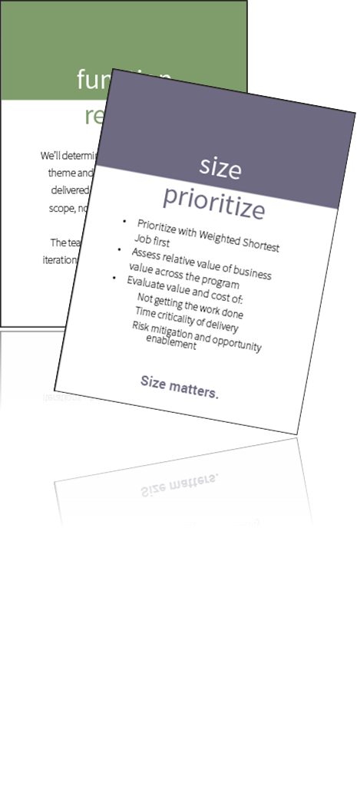
5 Iteration Planning
What to do
“Five” Iteration Planning maps out the functions that will be worked on in the next 5 (or so) iterations:
Brings team together to align prioritized functions
Allows the teams an opportunity to review dependencies across teams
Plan about how many iterations it will take to complete a function
Plan which functions will be worked on in which iterations
Inclusive of all functions – business, tech enablers, architecturally significant, etc.
Prioritization Discussion
Release Planning

Slide 7

5 Iteration Planning
What not to do
In “Five” Iteration Planning Don’t:
Elaborate 5 iterations of stories
Plan all functions to start in the first iteration and extend through 5 iterations
Forget about predecessors and their lead time
Forget about Tech Debt, Release Hardening, Architectural Runway
Stop Starting
Start Finishing

Slide 8
5 Iteration Planning
Who, When & Where
Technology
Feature Team:
Senior Analyst – Generally will lead the discussion
Master Craftsman – Generally will provide input into velocity and number of iterations each function will require
Architecture:
Provides input to any architecturally significant impacts
Needs awareness for lead-time if there are predecessors to consider
User Experience:
Provides input to any UX significant impacts
Needs awareness for lead-time if there are predecessors to consider
External Dependent Teams:
Provides input to any significant impacts
Needs awareness for lead-time if there are predecessors to consider
When
Every other week:
Recommended every other week on non-Iteration planning weeks. Giving the team an opportunity to close out functions from the prior iteration and assess progress, dependencies, etc. in current iteration
Where
Anywhere:
Azure DevOps if the team is using that as the system of record. If not, there is an Excel template on the Kingsmen Program Sharepoint site. A wall with taped off iterations is where it all began…make it work!
Business
Does not need to be included:
While the business may be invited, this is a technical meeting around what can / cannot be completed within specific iterations. Input on velocity, release timing, etc. should not influence this planning

Slide 9
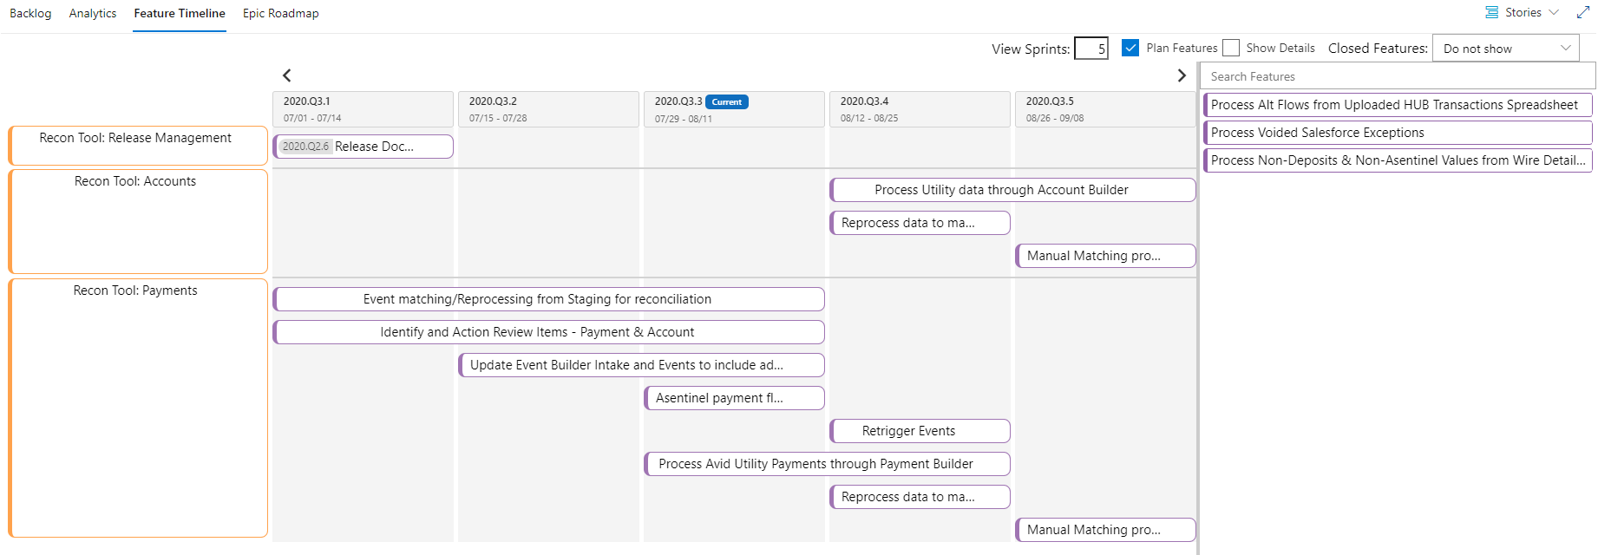
5 Iteration Planning
How

Slide 10
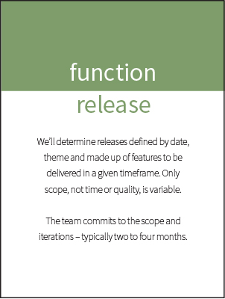
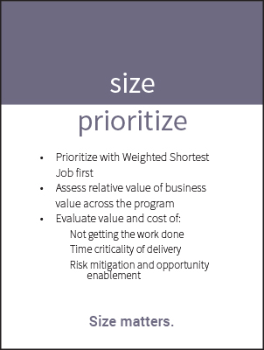
Function Elaboration
Function Elaboration further defines the features for a particular release:
Brings entire team together to break down features into functions
Allows the team an opportunity to discuss business cases, process flows and requirements
Size functions to further refine (and validate) the size of the feature
Recommend two passes per function: A first to high-level size for prioritization; a second to validate all assumptions when team is ready to begin
Recommend the team meets weekly

Slide 11
Function Elaboration
First and Second Pass
First Pass
High level implementation statement that describes the business function the product will perform.
May be the technical function required to enable a business function.
Only enough detail to enable technical lead to estimate size relative to other functions.
T-shirt size is documented
Generally done during Planning
Syntax:
As a <type of user> I want <some goal> So that <some reason>
I know I’m done <when> Out of scope items
Second Pass
Expand description based on updates since first pass.
Include details sufficient to meet definition of ready including:
Definition – Update if needed
Requirements – Potential user stories; usability, reliability, performance and supportability requirements
Considerations – Design, implementation, interface and physical considerations
Risks – Known or potential risks
Dependencies – Dependencies and who is managing/tracking the dependency
Out of Scope Items – Update if needed
T-shirt size is verified/updated

Slide 12
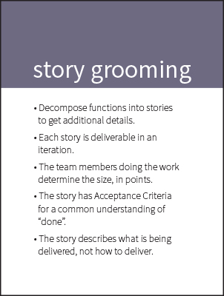
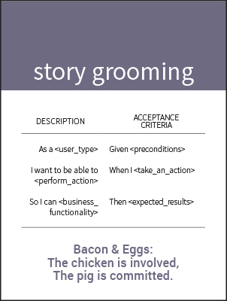
Story Elaboration
Story Elaboration further defines the functions for a particular iteration:
Brings entire team together to break down functions into stories
Allows the team an opportunity to discuss business cases, process flows and requirements
Size stories so they are of a size that they can be completed – development, testing and acceptance – in a two-week iteration
Recommend the team meets twice a week for ½ an hour

Slide 13
Progressive Story Elaboration
Story Title
Story Description
Acceptance Criteria
One line with a brief description of the story
As a <role>
I want to <goal>
So I can <why>
Role – who needs this functionality
Goal – what does the user what to accomplish
Why – why is this functionality important
Presented as scenarios that are testable:
Scenario
Given <preconditions>
When I <take_an_action>
Then <expected_results>
Scenario Outline
Given I have <start> dollars
When I <earn> dollars
Then I have <end> dollars
Examples:
| start | earn | end |
| 10 | 20 | 30 |
| 15| 20 | 35 |

Slide 14
Definition of Ready / Definition of Done
Definition of Ready = Criteria, as agreed on by the team, that determines when a work item is ready to be started. Required for a story to be brought into an iteration.
Definition of Done = Criteria, as agreed on by the team, that determines when a work item is complete. Required for a story to be accepted and a function to be released.

Slide 15





Story Sizing
Stories are sized to be completed in one iteration. If the story cannot be completed in a single iteration, it is broken into multiple stories.
Sizes are based on the Fibonacci Sequence: 1,2,3,5,8,13…
13 pts
8 pts
5 pts
3 pts
1 pt
2 pts
Consider breaking these into smaller stories

Slide 16
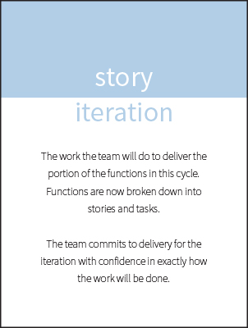
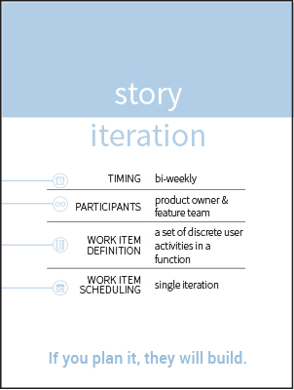
Iteration Planning
Iteration Planning determines the stories from the backlog that will be brought into the next iteration:
Brings entire team together to determine velocity and capacity of iteration
Allows the team an opportunity to validate story size and the stories ready for iteration
Commit to completing stories in next iteration
The team meets the first day of each iteration

Slide 17
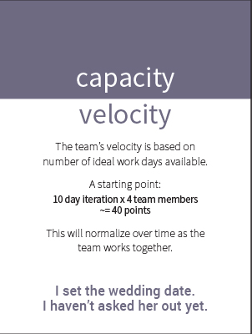
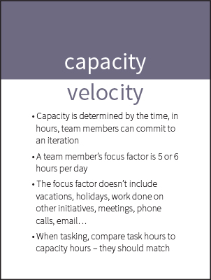
Capacity Planning
Capacity is the time, in hours, team members can commit to an iteration. Items to consider include:
Focus factor for a full day should be 6 hours given a 5x8 work-week (7.5 given a 4x10 work-week)
Don’t include time for vacations or holidays
Don’t include time for work being done for other initiatives
Sample Capacity:
Assume two-week iteration and focus factor of 6 hours | 6 hr/day * 10 days = 60 hr capacity
Assume two-week iteration, focus factor of 6 hours and team member with two days off | 6 hr/day * 8 days = 48 hr capacity
Assume two-week iteration, focus factor of 4 hours (new team member) | 4 hr/day * 10 days = 40 hr capacity
Total capacity for 3-member team | 148 hr

Slide 18
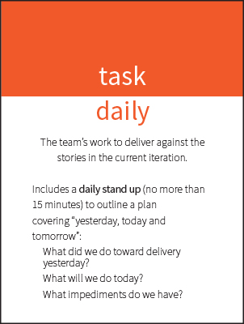
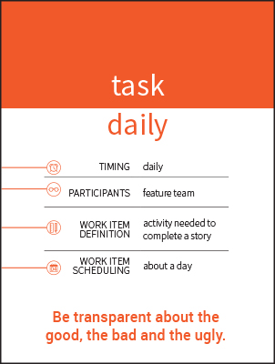
Tasking
Tasking stories allows the team to identify the daily tasks that must be completed to meet the definition of done for a story
Each team member that will contribute to completing the story enters that tasks required
Includes development, testing, automated testing
Tasks should not be more than 6 hours
Tasks include the hours it takes to complete

Slide 19
Daily Stand Up
Daily Stand Up is a quick pull up with the entire team to review the iteration:
Each team member should indicate what they did yesterday, what is planned for today and any impediments
Limited to 15 minutes a day
The team meets daily throughout the iteration (not Iteration planning day)

Slide 20


Do you have any
Questions?

